Slide 1
Double Linked List

Slide 2
Introduction to Double Linked List:
Definition: A data structure consisting of nodes where each node contains two pointers, one pointing to the previous node and the other pointing to the next node.
Characteristics: Provides bidirectional traversal and efficient insertion/deletion at both ends.

Slide 3
Structure of a Double Linked List:
Each node contain: Data: Holds the actual value or information.
Previous Pointer: Points to the previous node in the list.
Next Pointer: Points to the next node in the list.

Slide 4
Advantages of Double Linked List:
Bidirectional Traversal: Allows traversing the list in both forward and backward directions.
Efficient Insertion and Deletion: Adding or removing elements at the beginning or end of the list is efficient.
Flexibility: Nodes can be easily accessed and modified in both directions.

Slide 5
Disadvantages of Double Linked List:
Additional Memory Overhead: Requires extra memory to store the pointers for previous and next nodes.
Complexity: Slightly more complex implementation compared to singly linked lists.

Slide 6
Applications of Double Linked List:
Undo/Redo Functionality: Used in text editors to implement the undo and redo operations.
Cache Implementation: Doubly linked lists are used in cache eviction policies to efficiently remove least recently used items.
Deque (Double-Ended Queue): Doubly linked lists form the basis for implementing double-ended queues where insertion and deletion can happen at both ends.
Music or Video Player Playlist: Doubly linked lists can be used to create playlists with forward and backward navigation.

Slide 7
Complexity Analysis:
Searching: O(n)
Insertion/Deletion at the beginning or end: O(1)
Insertion/Deletion at a specific position: O(n)

Slide 8
Circular Linked Lists A Linked List with No End!

Slide 9
Introduction to Circular Linked Lists
A circular linked list is a variation of a linked list where the last node points back to the first node, creating a circular structure.
In a traditional linked list, the last node points to NULL, indicating the end of the list.
In a circular linked list, the last node points back to the first node, forming a loop.

Slide 10
Types of Circular Linked Lists
Singly Circular Linked List:
Each node contains a data element and a pointer that points to the next node in the list.
The last node points back to the first node, forming a circular structure.
Traversal is possible in a forward direction only.

Slide 11
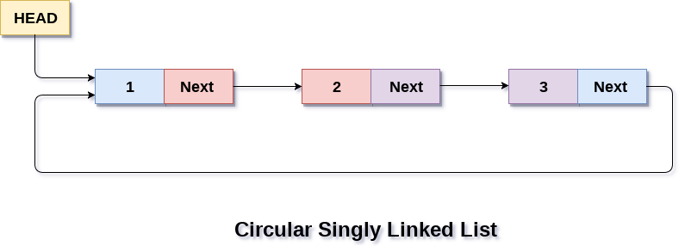

Slide 12
Doubly Circular Linked List:
Each node contains a data element and two pointers: one that points to the next node and another that points to the previous node.
The first node's previous pointer points to the last node, and the last node's next pointer points to the first node, forming a circular structure.
Traversal can be done in both forward and backward directions.

Slide 13
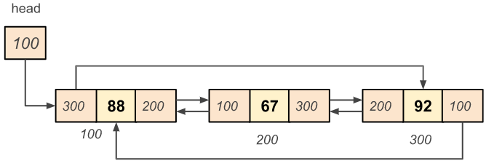

Slide 14
Key Features of Circular Linked Lists
Circular Structure:
The last node of a circular linked list points back to the first node, creating a continuous loop.
There is no "end" or "NULL" pointer in the last node.
Traversal and Operations:
Traversing a circular linked list involves starting at any node and visiting all subsequent nodes until reaching the starting node again.
Insertion, deletion, and other operations can be performed on circular linked lists, similar to traditional linked lists.

Slide 15
Advantages of Circular Linked Lists
Efficient Operations:
Circular linked lists provide quick access to both the beginning and end of the list.
Operations like insertion or deletion at the beginning or end of the list can be performed in constant time.
Iterative Operations:
Circular linked lists are suitable for applications that involve continuous iterations or loops.
They provide a natural way to traverse and process elements in a circular manner.

Slide 16
Applications of Circular Linked Lists
Circular linked lists are used in various scenarios, including:
Round-Robin Scheduling: In operating systems, circular linked lists are employed for task scheduling algorithms, where each process gets a fair share of CPU time.
Circular Buffers: Circular linked lists are utilized to implement circular buffers or ring buffers, which are commonly used in embedded systems and data streaming applications.
Game Development: Circular linked lists are helpful for creating game elements that move in a loop or follow a circular pattern.

